Slide 1






ROCKBUSTER STEALTH LLC SALES ANALYSIS
Güldeniz Şensoy
21.01.2022

Slide 2
PROJECT MOTIVATION & OBJECTIVE
Rockbuster Stealth LLC is facing stiff competition from streaming services such as Netflix and Amazon Prime.
In order to stay competitive, the management team is planning to use its existing movie licenses to launch an online video rental service.
The objective is to develop a new business strategy to launch our online video services in 2020.

Slide 3
KEY QUESTIONS & OBJECTIVES
Which countries are Rockbuster customers based in?
Do sales figures vary between geographic regions?
Which movies contributed the most/least to revenue gain?
What was the average rental duration for all videos?
Where are customers with a high lifetime value based?
Geographical distribution of customers and revenue
Best and worst films for revenue gain
Important values of the films in the archive
Rewarding the loyal customers

Slide 4
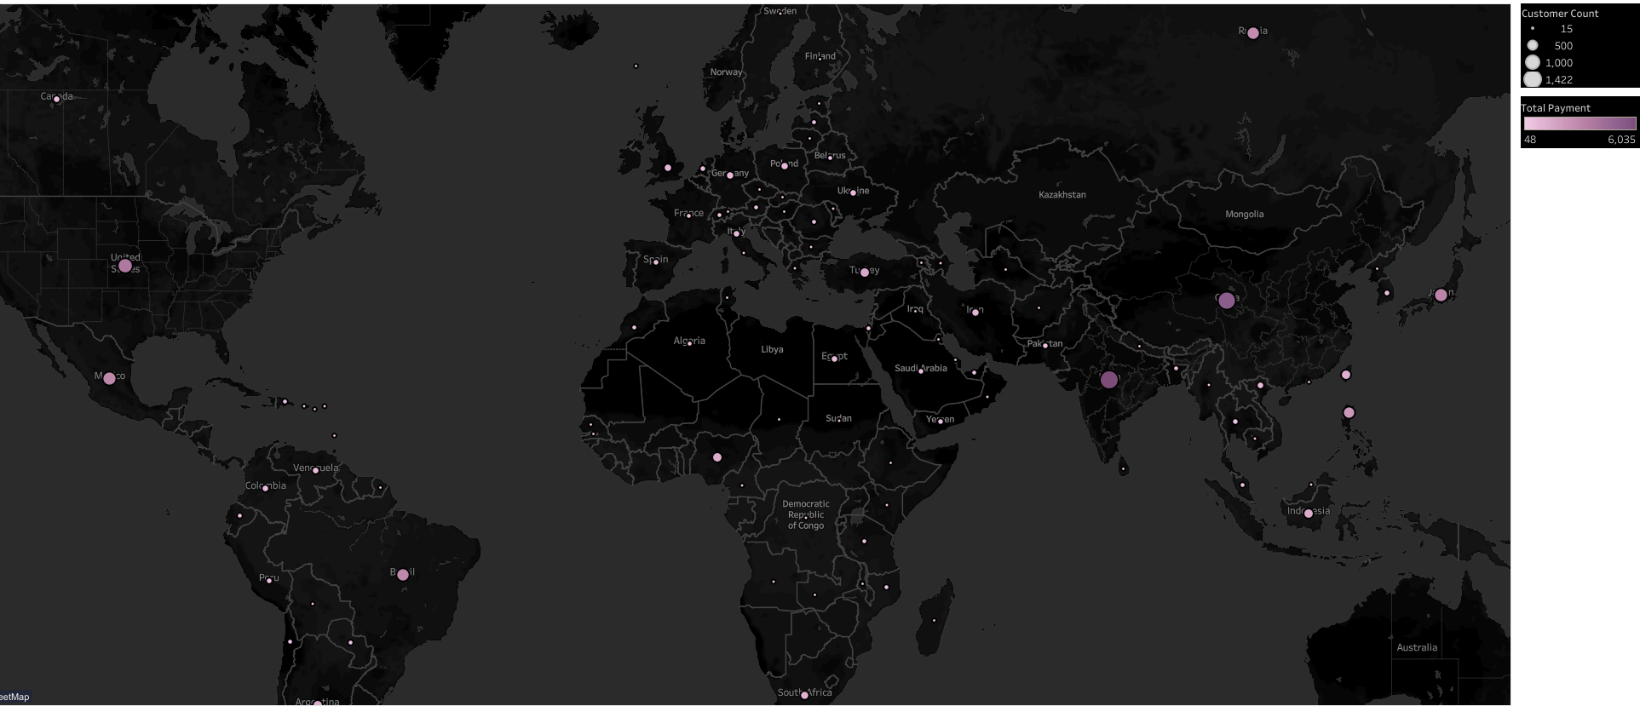
Current world-wide customers and revenues
This graph shows a general view of Rockbuster Stealth’s customer-base and the revenue it generates.
As we can see from the map, Rockbuster has a diverse customer base from almost all over the world.
Thanks to the distribution of this customer base, Rockbuster is able to generate revenue from various regions of the world.

Slide 5
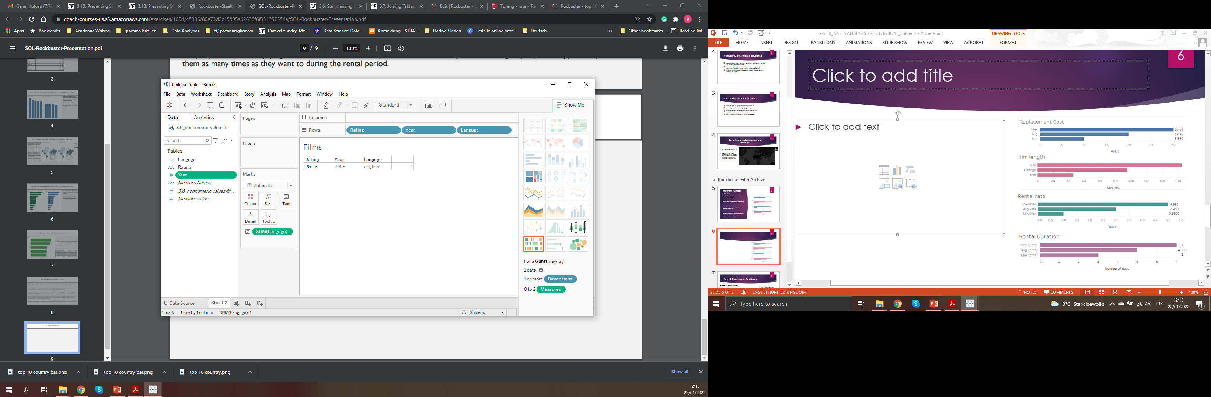
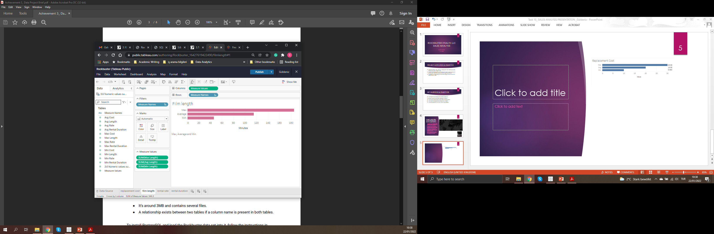
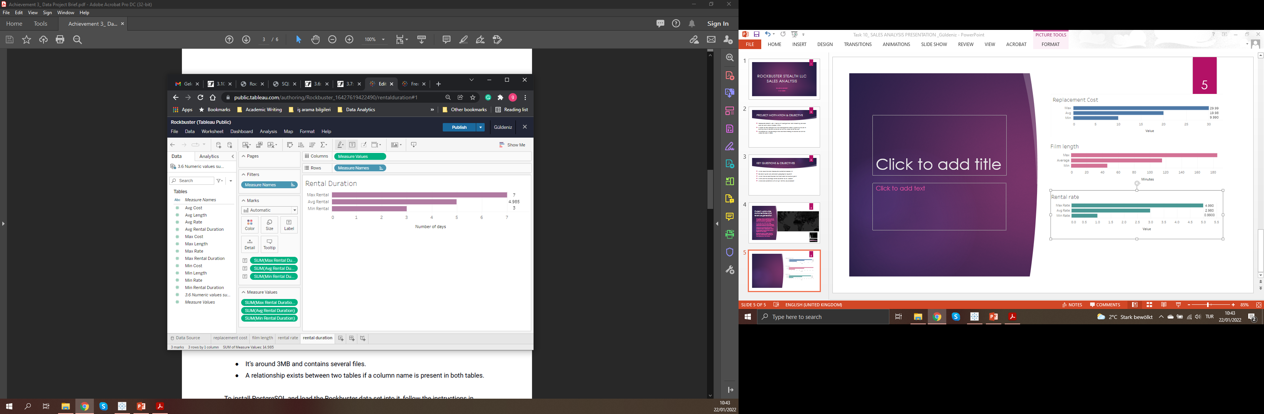
Let’s Check Our Film Archive
Most of the flm in the archive has the PG-13 rating, while all of the films are in english and released in 2006.
The duration of the films Rockbuster has in the archives ranges from 40 minutes to 180 minutes. The average film duration around 120 min.
Rockbuster allows max of 7 day of rental while the minumum number days for rental is 3. The films on average are rented for approximately 5 days.

Slide 6
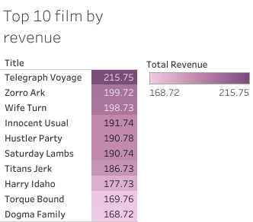
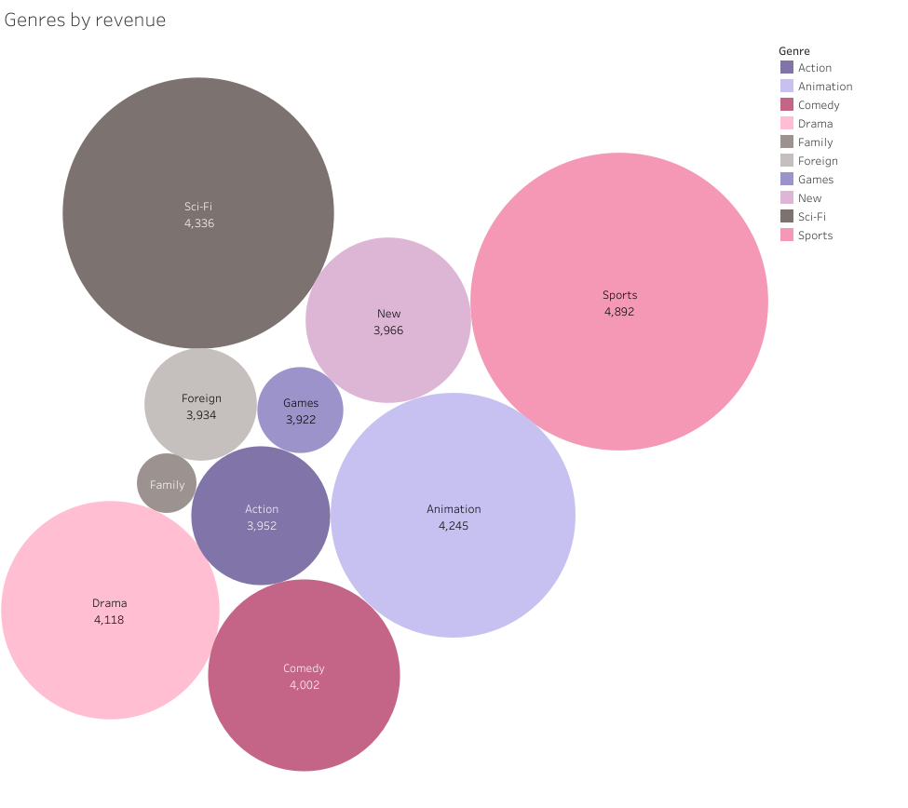
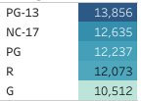
Let’s Check Our Film Archive
Table 1. Top 10 films for revenue gain
Graph 1. Top 10 genre by revenue gain
Top films, genres and ratings by revenue
The table.1 shows the film that bring the most revenue for Rockbuster. Best film for revenue-vise is «Telegraph Voyage»
Table 2 indicates how much Rockbuster earns from each rating. PG-13(parental guidance under 13) brings the most revenue while G(general audience) brings the least.
The graph on the right shows the top 10 genre by revenue. The most profitable genre is ‘Sports’ for the company.
Table 2. Ratings by revenue

Slide 7
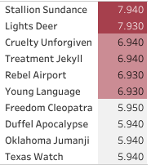
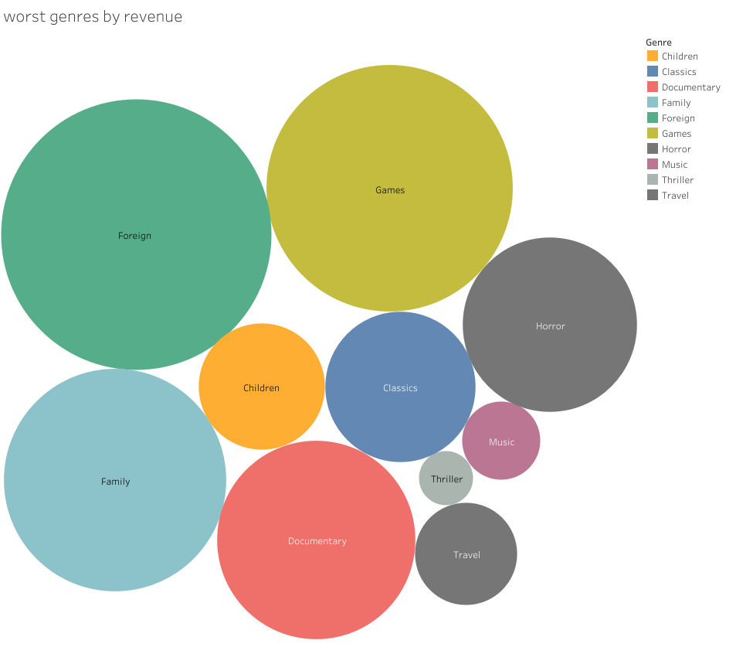
Let’s Check Our Film Archive
Table 3. 10 worst films for revenue gain
Graph 2. Bottom 10 genes for revenue gain
Top films, genres and ratings by revenue
The Table 4 shows the film that bring the least revenue for Rockbuster.
G is the rating category that brings the least revenue.
Tha graph on the left shows the bottom 10 genre. The least profitable genre by far is ‘Thriller’ for the company.
Table 4. Ratings by revenue

Slide 8
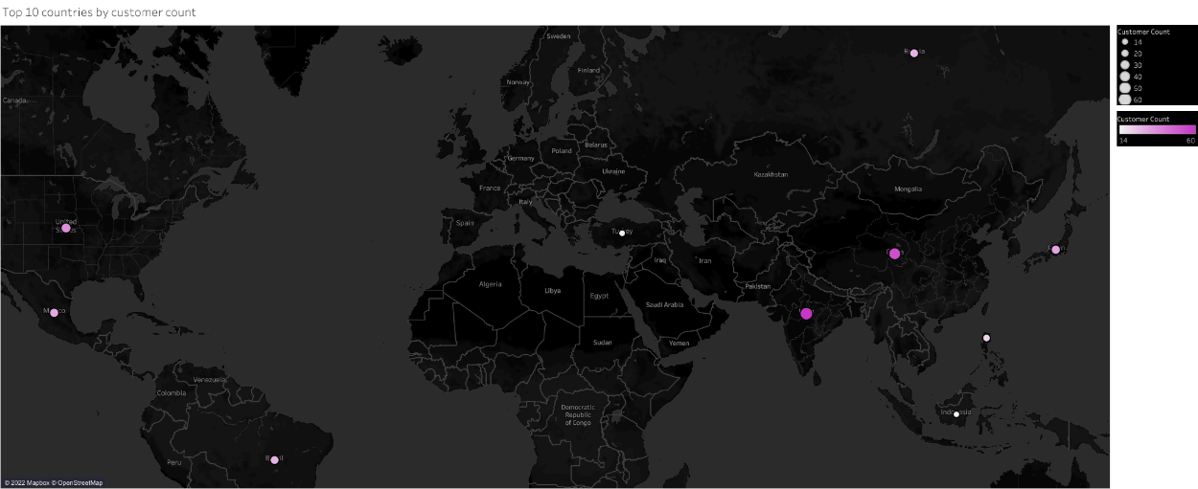

TOP 10 COUNTRIES FOR ROCKBUSTER
Top 10 countries by customer count
India
China
United States
Japan
Mexico
Brazil
Russian Federation
Philippines
Turkey
Indonesia

Slide 9
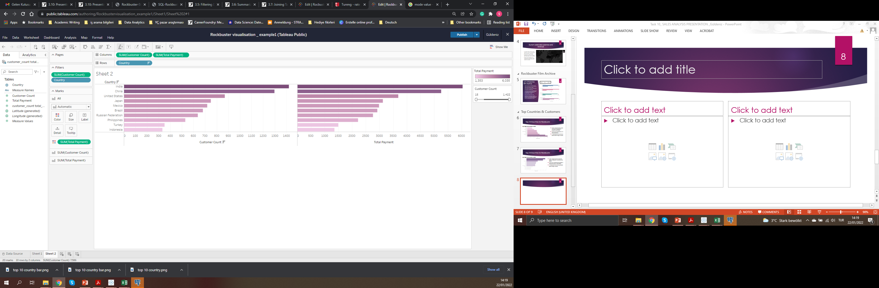
Top 10 Countries by customer and revenue
These 10 countries are where the most of Rockbuster’s customers are based and the most of the revenue is generated.
In these countries, buildling a better brand image is crucial.

Slide 10
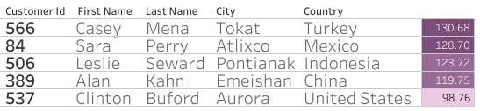
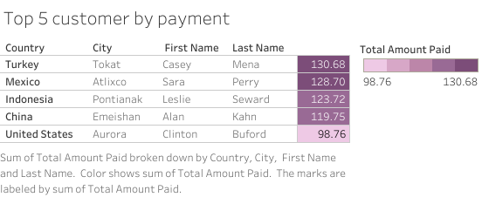
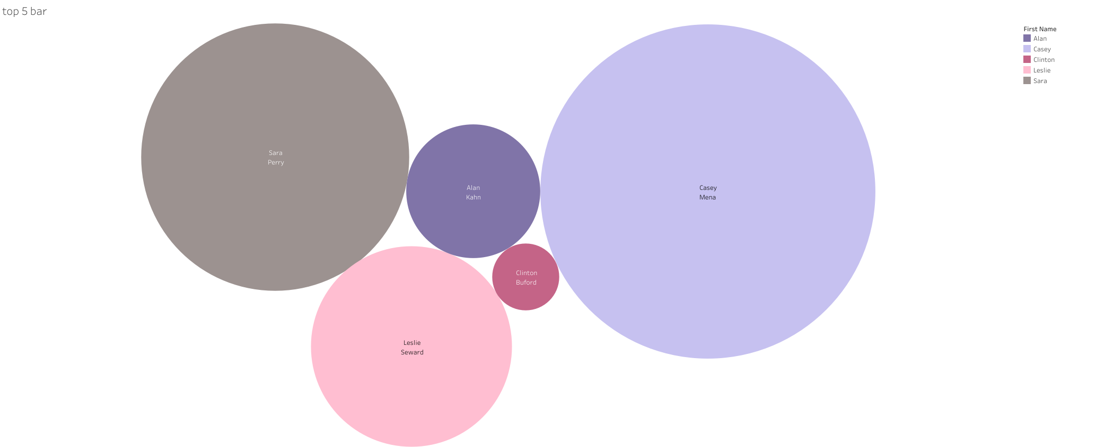
Top 5 Customers of Rockbuster
Top 5 customers by total payment
In these 10 countries, there are especially 5 cities in which our most paying customer lives.
Casey Mena from Tokat, Turkey
Sara Perry from Atlixco, Mexico
Leslie Seward from Pontianak, Indonesia
Alan Kahn from Emeishan, China
Clinton Buford from Aurora, US

Slide 11
CONCLUSIONS & RECOMMENDATIONS
Rockbuster has a diverse customer-base in varous countries ans cities all around the world. The company gets most of its revenues from India, China, United States, Japan, Mexico, Brazil, Russian Federation, Philippines, Turkey, and Indonesia. More attention should be given to these countries in terms of Providing service.
This may include integrating a better brand image
Better customer service
More language option (subtitles, dubbing) for the countries
The most loyal and most paying customers should a rewarded.
They can get certain discount when they rent xth film, or when they refer Rockbuster to other people.
In order to gain more revenue from the film selection, the number of «most loved» film genres such as, sports, science fiction, and animation should be increased on the stock. On the other hand, thriller genre needs not be expanded.
Rockbuster company should also pay a special attention to film rating when enhanhing the film stocks. PG – 13, NC – 17, and PG are the best selling ratings.

Slide 12
ANY QUESTIONS?
THANK YOU FOR YOUR INTEREST!
Please reach out for more details:
GÜLDENİZ ŞENSOY
guldeniz.sensoy@gmail.com

